Slide 1
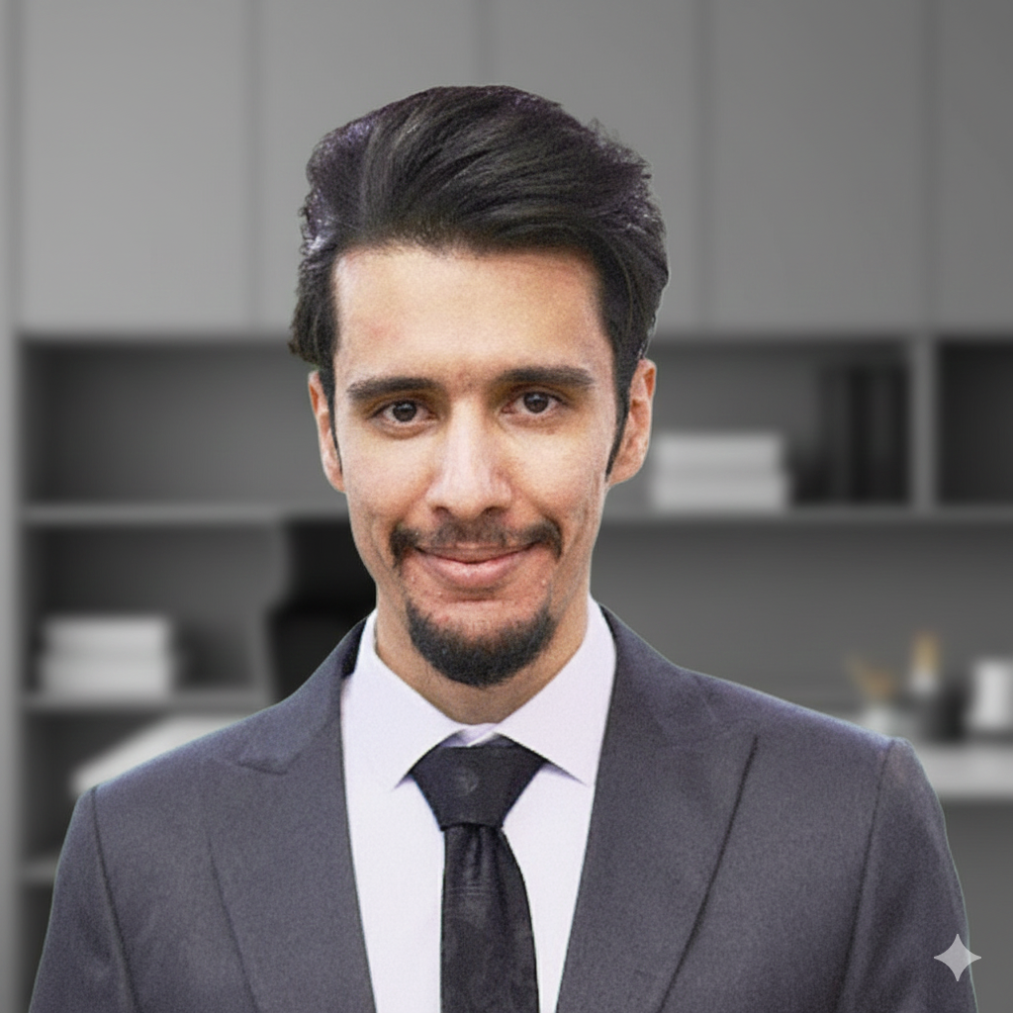
Sina Lalehbakhsh
Django Backend Engineer –
Data & Performance

Slide 2
I am a results-driven Django backend engineer focused on data modeling, ORM optimization, and high-performance database queries.

Slide 3


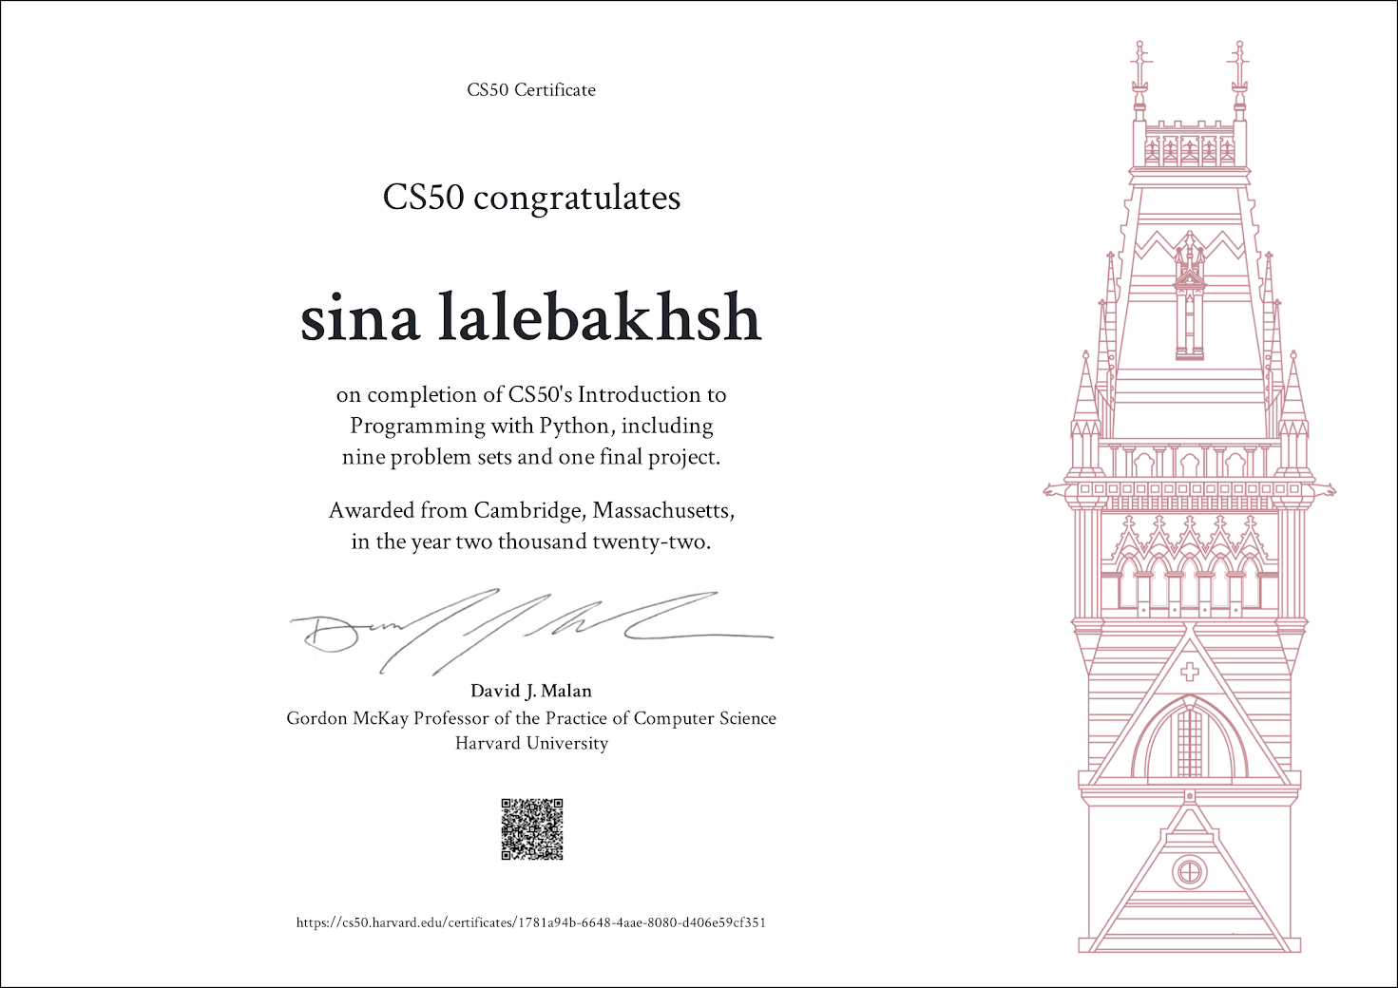

Career highlights
Foundational Cloud Practitioner
From Arvan Academy
DevOps Engineer
From Arvan Acadeny
Introduction of Python from EDX.com

Slide 4




Specialized accounts
https://pypi.org/user/sinalalebakhsh/
https://github.com/sinalalebakhsh
https://stackoverflow.com/users/17351206/sina-laleh-bakhsh

Slide 5
Released packages
https://pypi.org/project/git-auto-django/
https://github.com/sinalalebakhsh/acronproject
https://github.com/sinalalebakhsh/push-py

Slide 6
My career journey
2010 – 2020
2020– 2026
2021 – 2026
Basic Language of Python
Python – Django – Git – BASH – JavaScript – Linux – Ansible – Docker- etc
GitHub Account professional – AcronProject Repository

Slide 7





Media work (educational content production)
2020 – Now
2025 - now
2023 – Now
https://www.youtube.com/@acronproject
https://t.me/acronproject
https://www.instagram.com/acronproject
Click here …
Click here …
Click here …

Slide 8
Core skills
Django
Linux and Containers (Docker)
FastAPI – DRF
DataBase - MySQL
DevOps & Cloud

Slide 9
Detail skills
Django ORM-Query-
Linux and Containers (Docker) –Compose
FastAPI – DRF –Serialization - CBV
DataBase – MySQL – NoSQL MongoDB
DevOps & Cloud CI/CD

Slide 10

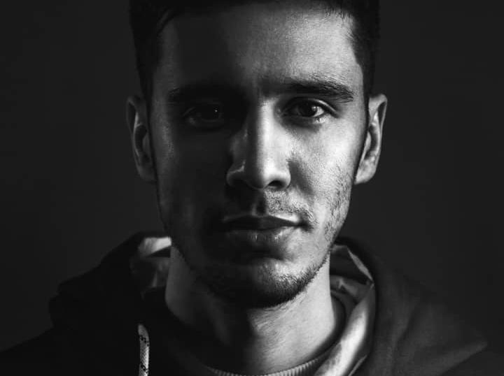
Art impact & Creative Background
Background in Visual Communication and graphic design
Practical experience in sculpture and 3D artistic forms
Logo and visual identity design with conceptual focus
Portrait drawing and painting with attention to detail and expression

Slide 11
Education history
2011
Geraphic-Kamalolmolk
2020
Python Harvard EDX.com
2025
Associate DevOps Engineer
2025
Foundational Cloud Practitioner

Slide 12

Connect with me
LinkedIn
https://www.linkedin.com/in/sina-lalebakhsh/
Github
https://github.com/sinalalebakhsh
Email
sinalalehbakhsh@gmail.com
Arvan Academy
https://academy.arvancloud.ir/members/0bbb1ece/

Slide 13
Connect with me
Cellphone
09126507649
WhatsApp
09126507649
Telegram urs:
sinalalebakhsh
BlueSky
https://bsky.app/profile/sinalalebakhsh.bsky.social

